Slide 1
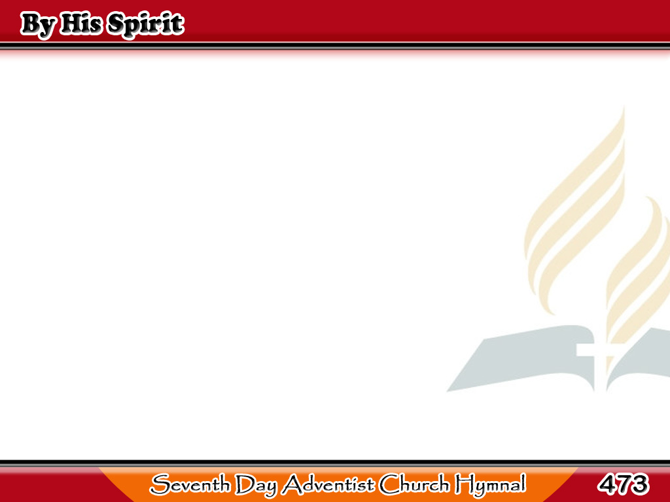
Kanyang Espiritu
Not by man’s own
might nor power
Will God’s work
on earth be done,
1/2

Slide 2
Kanyang Espiritu
But by His Spirit,
His mighty Spirit,
Will the blessed
kingdom come.
1/2

Slide 3
Kanyang Espiritu
Not by might nor by power,
Not by might nor by power,
But by His Spirit, His Holy Spirit
Will the work be done.
1/2

Slide 4
Kanyang Espiritu
But God needs you,
O dear Christian,
And for you He calls to day,
2/2

Slide 5
Kanyang Espiritu
That by His Spirit,
His mighty Spirit,
You may show the lost His way.
2/2

Slide 6
Kanyang Espiritu
Not by might nor by power,
Not by might nor by power,
But by His Spirit, His Holy Spirit
Will the work be done.
2/2

